Slide 1


Analysis and Modeling Individuals’ Selection of Partners in a Speed-Dating Experiment
CS3481 Project 2
CHEN Jiaqing 55202577
LI Haotian 54780576
LI Zhiwei 54780945
WANG Yinuo 55670000

Slide 2
CONTENTS
1
Background Introduction
- Speed-dating experiment
2
Data Preprocessing and Visualization
Data cleaning & Normalization & Feature Engineering
Visualization: Population Fraction & Preference factor, Similarity
3
Modeling and Evaluation
Model: KNN & Logistic Regression & Decision Tree & Naïve Bayes
Evaluation: AUC & PRC & Confusion Matrix
4
Conclusion
Comparison and discussion

Slide 3
1
Background Introduction
PART 01

Slide 4

Speed-Dating Experiment
Look
How to be the apple of your eyes?
Features
Senses

Slide 5
Dataset
The dataset is downloadable at Kaggle.
Ranking data of two dating partners
Preferred feature of the "dream lover"
Result to predict is whether the two dating partner is matched or not

Slide 6
2
Preprocessing & Visualization
PART 02

Slide 7
Preprocessing
Unify Rating Scheme
Data Cleaning
Feature Engineering
Data Normalization

Slide 8
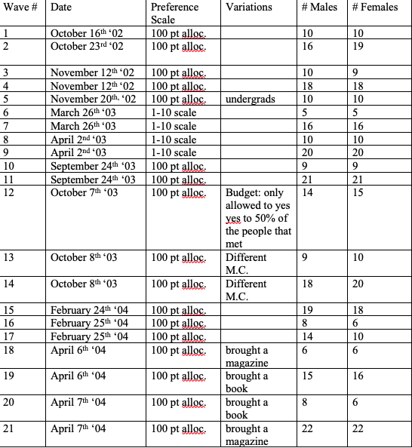
Rating Scheme

Slide 9
Data Cleaning
1. Feature Selection
2. Filled Null value

Slide 10
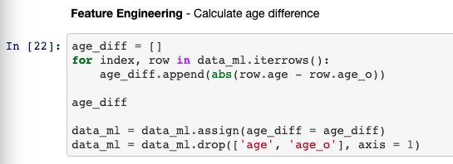
Feature Engineering
Combine columns together.

Slide 11
Data Normalization
Percentage Normalization (numerical)
Minmax Normalization (numerical)
One-hot Encoding (categorical)

Slide 12
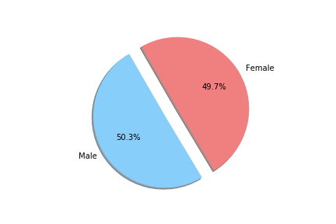
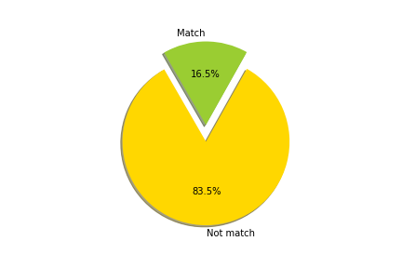
General Analysis
Gender Distribution
Dating Result

Slide 13
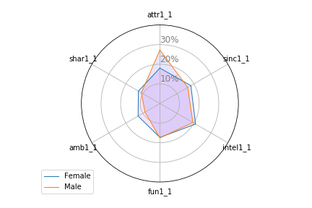
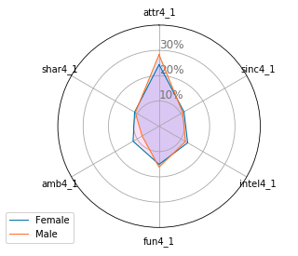
General Analysis
Participants think fellow men/women look for in the opposite sex.
What participants look for in the opposite sex

Slide 14
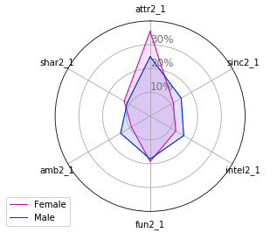
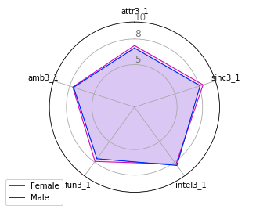
General Analysis
Participants think the opposite sex looks for in a date.
how do you think others perceive you?.

Slide 15
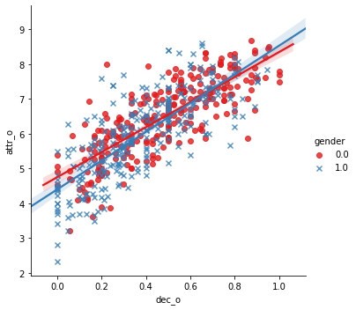
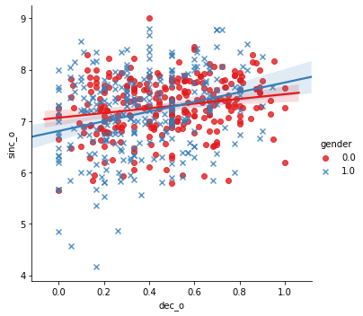
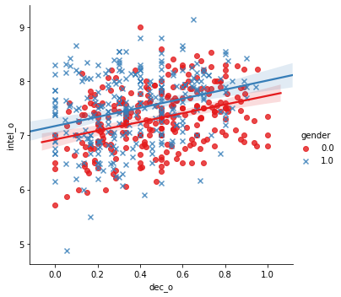
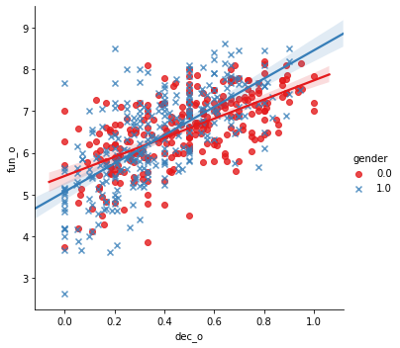
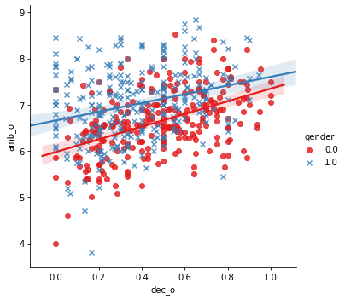
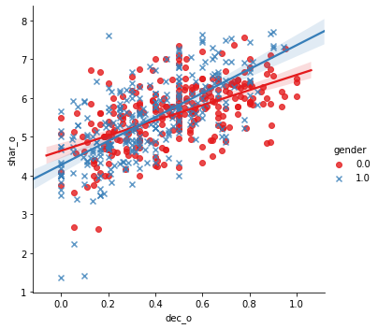
General Analysis
Features & Decision
Attractiveness
Sincere
Intelligent
Fun
Ambitious
Shared Interests

Slide 16
3
Modeling and Evaluation
PART 03

Slide 17
Methodology
K-Nearest Neighbor
Decision Tree
Naïve Bayes
Logistic Regression

Slide 18
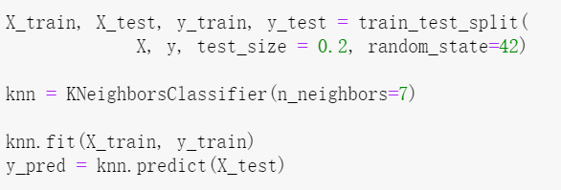
Modeling - K-Nearest Neighbor
Theorem: make predictions based on k nearest neighbors
Input: D={(x1 , y1 ), (x2 , y2 ), ⋯, (xN , yN )}
Output: y=arg maxcj xi ∈Nk (x)∑/ (yj =cj ),
(i=1,2,⋯,N ; j=1,2,⋯,K )
Accuracy: 82.9433%

Slide 19
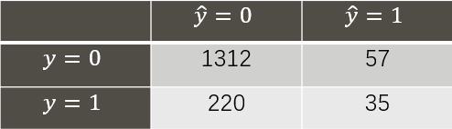
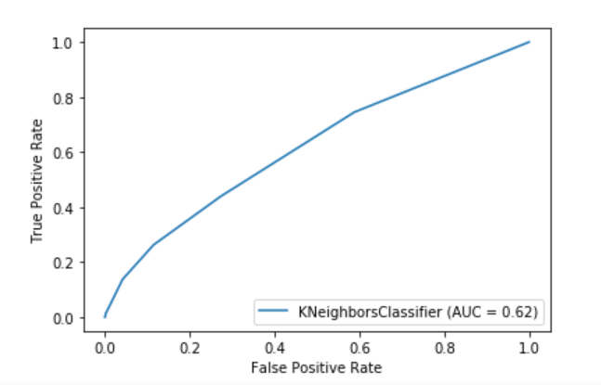
Evaluation - K-Nearest Neighbor
Confusion Matrix
Precision: 85.64%
NPV: 38.04%
Recall: 98.84%
Specificity: 13.17%
F-score: 90.45%
ROC-AUC: 0.62±0.1
k∈ [6, 16]
Has room for improvement
Conclusion
Imbalance of positive samples ​
over negative samples
Need more samples to test​

Slide 20
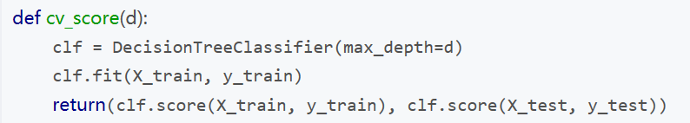
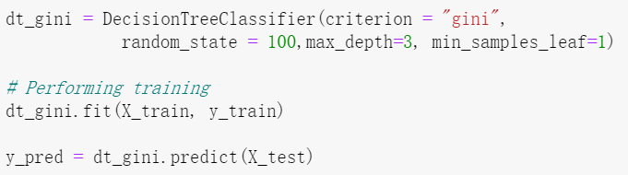
Modeling - Decision tree
Theorem: each leaf node represents a classification result
Parameter: criterion is set to "gini" AND "entropy"; the max_depth value did not affect the result, and best min_samples_leaf is default 1.
Accuracy: 84.2980%

Slide 21
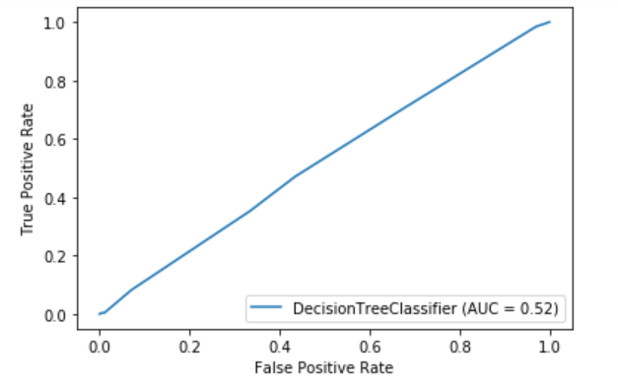
Evaluation – Decision tree
Confusion Matrix
Precision: 84.29%
NPV: undefined
Recall: 100%
Specificity: 0%
F-score: 91%
ROC-AUC: 0.52
Not satisfactory
Conclusion
Imbalance of positive samples ​
over negative samples
Need more samples to test
 | 𝑦^=0 | 𝑦^=1
𝑦=0 | 1369 | 0
𝑦=1 | 250 | 0

Slide 22
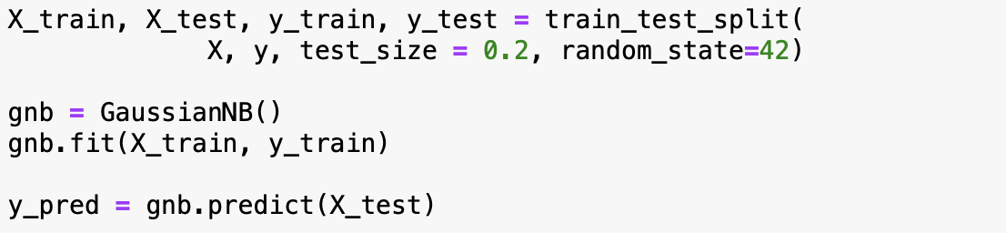

Modeling - Naïve Bayes
Bayes Theorem: $P\left(y \right| x_{1},x_{2},…,x_{n})=\frac{P\left(y\right)P\left(x_{1},x_{2},…,x_{n} \right| y)}{P(x_{1},x_{2},…,x_{n})}$
Assumption: Conditional independent
Classification rule: $\hat{y}=\arg{\max_{y}{P\left(y\right)\prod_{i=1}^{n}{P\left(x_{i} \right| y)} }}$
Accuracy: 84.0517%

Slide 23
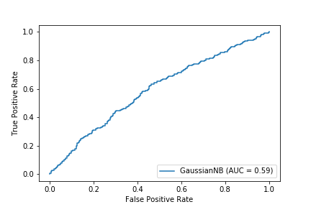
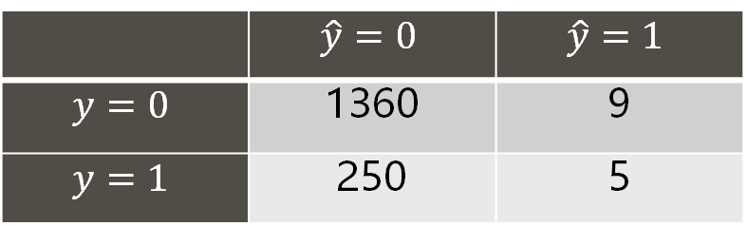
Evaluation - Naïve Bayes
Confusion Matrix
Precision: 84.47%
NPV: 35.71%
Recall: 99.34%
Specificity: 2%
F-score: 91%
ROC-AUC: 0.59
Not satisfactory
Conclusion
Tend to be conservative
Prefer non-match prediction
 | $$\hat{y}=0$$ | $$\hat{y}=1$$
$$y=0$$ | 1360 | 9
$$y=1$$ | 250 | 5

Slide 24
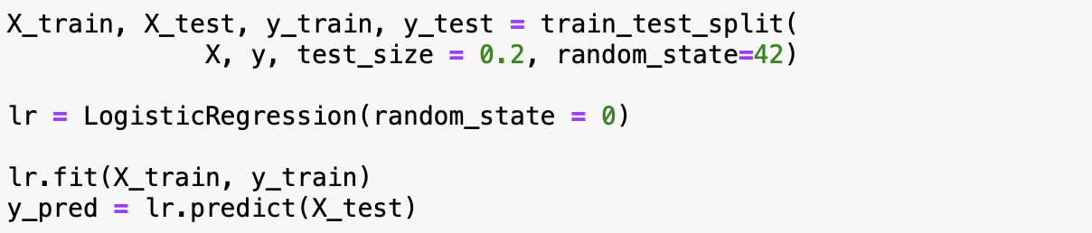

Modeling – Logistic Regression
Regression method & Classification problem
Fit into Sigmoid Function: $sigmoid\left(x\right)=\frac{1}{1+e^{−z}}$
Prediction: Probability of certain class
Accuracy: 84.2980%

Slide 25
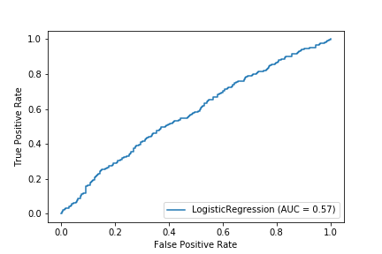

Evaluation – Logistic Regression
Confusion Matrix
Precision: 84.29%
NPV: undefined
Recall: 100%
Specificity: 0%
F-score: 91%
ROC-AUC: 0.57
Not satisfactory
Conclusion
Give all pairs "fail to match”
Need more samples to test
 | $$\hat{y}=0$$ | $$\hat{y}=1$$
$$y=0$$ | 1369 | 0
$$y=1$$ | 255 | 0

Slide 26
Performance Evaluation
Classifier | Accuracy | AUC
KNN | 82.94% | 0.62
Decision Tree | 84.30% | 0.51
Naïve Bayes | 84.05% | 0.59
Logistic Regression | 84.30% | 0.57
Higher accuracy: Decision Tree, Logistic Regression
Predict all: non-match
Meaningless
Higher AUC: KNN, Naïve Bayes
More meaningful
Imbalanced-label data

Slide 27
4
PART 04
Conclusion

Slide 28
Discussion
It is difficlut to predict human's behaviour, especially in emotional topic.
Even though we used powerful classifier, they showed weak prediction ability in predicting such human decisions.
There are several questions exist in the real world:
One ranked high on the other but they did not match with each other.
The rank point of two experiment participants is not high, but they matched in the end.

Slide 29
Our Suggestion
Short Term
Long Term
Surface Feature
Attractiveness
Fun
Shared Interests
Underlying Feature
Ambition
Sincereness
Intelligence

Slide 30
Reference List
[1] Björkgren, Andreas & Brodin, Henrik, 2005, http://www.diva-portal.se/smash/get/diva2:4018/FULLTEXT01.pdf
[2] Columbia University Libraries, “Gender Differences in Mate Selection: Evidence from a Speed Dating Experiment,” Academic Commons, Available: https://academiccommons.columbia.edu/doi/10.7916/D8FB585Z

Slide 31
Thank you for listening
Project GitHub link: https://github.com/blueice930/cs3481-project2​
All project's materials including datasets, documents, source codes and graphs can be found on GitHub.

